Slide 1
Does social structure modulate linguistic priming?
Phd Student: Kerime Eylul Eski
Tutor: Luca Onnis
Dottorato in Scienze Sociali. Curriculum Psicologia e Scienze Cognitive
XXXVII ciclo

Slide 2
Syntactic Priming
Syntactic priming: a general tendency for language users to produce a syntactic structure following previous experience with that structure
The effect of structural priming has been observed in
adults (J. K. Bock, 1986)
children (Bencini & Valian, 2008)
comprehension (Arai et al., 2007)
production (Pickering & Branigan, 1998)
across different languages (Hartsuiker et al., 2016)
Notes:
Compared to language mechanisms that function at an individual level, we know much less about the mechanisms that allow linguistic forms to spread socially.
Limited number of studies used syntactic priming paradigm to investigate language production in communicative environment.

Slide 3
Simple and Complex Contagion
Different types of human behavior, spread through different social mechanisms
Simple behavioral contagion: a single contact
Complex behavioral contagion: multiple sources of exposure/contact
Does human language spread primarily as a virus? Or as a form of complex behavioral contagion?

Slide 4
Objectives
One mechanism of syntactic use investigated: passive and active diathesis
Two conditions: egonet-1 and egonet-6
Six players (confederate bots, unbeknownst to them)
Egonet-1 condition: primed with passives by one person
Egonet-6 condition: primed with passives by six people
If the social structure modulates linguistic behavior:
a difference in terms of the amount of priming
more spontaneous priming in egonet-6 condition
Notes:
In these experiments, specifically, one mechanism of syntactic use was investigated: passive and active diathesis

Slide 5
Study I
Aim: to examine whether the syntactic priming task is working, and is able to prime participants with passive sentence structure
Only egonet-6 condition
Participants
20 participants from Prolific
Native English speakers.

Slide 6
Task – Picture Description Game
David: the man is hit by a bus
David (Bot)
The participants first read sentences that are the description of a picture written by other players (confederate bots)
Notes:
The task involves a picture description game which is played in pairs, and in turns. The participants first read sentences that are the description of a picture written by other players who are actually confederate bots. The sentences were either fillers or primes that are constructed in passive form.

Slide 7
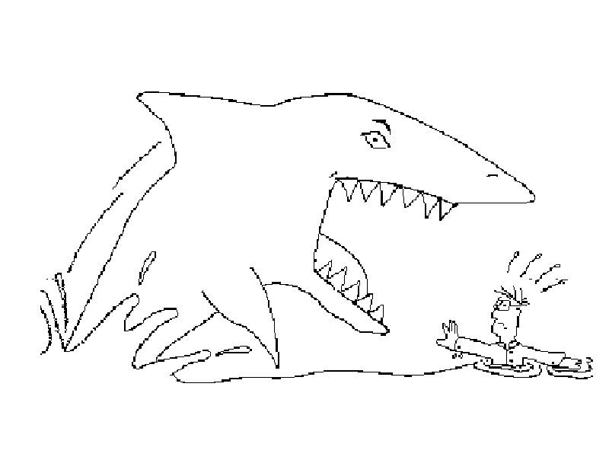
Task – Picture Description Game
Filler Picture Target Picture
Target images can be described either in passive or active form
e.g. Shark is attacking a man and Man is attacked by a shark
Notes:
After reading the sentences, participants were presented with target and filler images to describe. Target images can be described either in passive or active form. For example, shark is attacking a man, or man is attacked by a shark.

Slide 8
Procedure
Instructions:
They will be asked to play a game online with other players
Playing as a team against other teams
Do not take breaks during the game as taking breaks may disrupt the structure of interactive study
Coding:
Passive: patient of the picture as the subject of the sentence, a verb in passive voice, a by phrase following the verb, and the agent of the action as the object of by
Actives: agent as subject, a verb in active voice, and the patient as direct object
Neither: truncated passives, adjectival passives and active sentences with intransitive verbs
e.g. Snowballs are falling onto the man >> neither
Notes:
An adjectival passive is a verb phrase that contains the verb "be" or another linking verb such as "look," seem," "appear," sound," taste," etc. plus an adjective formed from a past participle. It is not a full clause, only a verb phrase.

Slide 9
Results
Percentages of Passive, Active (Neithers excluded)
Our study Baseline (Bock & Griffin, 2000)
Passive >> 43.3% Passive >> 42%
Active >> 56.7% Active >> 58%
>> Out of 306 items, 112 neither

Slide 10
Discussion
Challenge:
Creating an illusion of an interactive environment
High number of “neither”
“The choice between active and passive sentences is sensitive to the conceptual characteristics of messages, with the occurrence of passives strongly associated with inanimate or nonhuman agents” (Clark, 1965; Clark & Begun, 1971)
Solution:
Stimuli’s modality from written to audio
New pictures with pictures that involve nonhuman agent
Notes:
Our task failed to prime the participants.
One of our challenge was to create the illusion that participants are playing with real people. To increase this effect, we decided to change half of the stimuli’s modality from written to audio.
Another problem was the high number of sentences that are scored as “neither”. Passive structure has been known to be associated with inanimate or nonhuman agents.
Therefore, we changed half of our targets to pictures that involve nonhuman agent.

Slide 11
Study II
Main goal: to investigate the difference between egonet-1 and egonet-6
Prime + Filler
Prime + Filler
Prime
Filler
Prime + Filler
Prime + Filler
Filler
Filler
You
You
Prime + Filler
Prime + Filler
Filler
Filler
Egonet 6
Egonet 1

Slide 12
Study II
Participants
61 participants
Native English speakers
Task
The renewed version of priming task
Half of the written sentences were changed to audio
Nine new target pictures
Procedure
Same procedure as Study I

Slide 13
Coding
Additionally, truncated passives were also accepted as passives
Truncated passives does not express the logical subject
No “by” and “agent as an object”
e.g. The window was broken
Notes:
The coding procedure was almost the same as Study II. Additionally, truncated passives were also accepted as passives as it can be particularly hard to prime participants in online and written production task (Mahowald et al., 2016).

Slide 14
Results
Table 1
Percentages of Passive, Active and Neither
Utterance form
Priming Condition | Active | Passive | Neither
Egonet-1 | 30.5 | 38.2 | 31.3
Egonet-6 | 32.9 | 32 | 35.1
Notes:
Table 1 shows the percentages of active, passive and neither categories in both conditions. A considerable number of the answers was categorized as neither for both conditions.

Slide 15
Results
Table 2
Fixed effects:
 | Estimate | Std. Error | z value | Pr(>|z|)
(Intercept) | 0.1273 | 0.2651 | 0.48 | 0.631
condition1 | -0.2015 | 0.1528 | -1.318 | 0.187
Linear mixed effect logistic regression with random intercepts for subject and item, and Egonet condition (1 vs 6) as fixed effect
Notes:
To investigate the difference between two groups, we used linear mixed effect logistic regression with random intercepts for subject and item, and Egonet condition (1 vs 6) as fixed effect.

Slide 16
Results
Great variance between participants
Notes:
There is a great variance between participants.

Slide 17
Discussion
No significant difference between egonet-1 and egonet-6 condition
May be related to the design of our task: requires participants to listen or read the prime sentences
The percentage of “neither” category did not significantly decrease
Participants were not under the observation of the experimenter >> might cause to put less effort
Variance across participants may have arisen from these factors
The percentage of priming increased from 43% to 49% and 56%
Further improvements are needed to test our hypothesis in a more reliable way
Notes:
Our study showed that there was no significant difference between egonet-1 and egonet-6 condition. The lack of significance may be related to the design of our task. Our renewed task required participants to listen or read the prime sentences. This may make the task relatively more complicated than our first task. In fact, more participants were unable to complete the task or completed it wrong.
Although we replaced the items, the percentage of “neither” category did not significantly decrease. Since the study was online, participants were not under the observation of the experimenter. This might cause for some participants to put less effort. Variance across participants and high number or “neither” may have arisen from these factors.
In spite of these challenges, our design showed a significant improvement. The percentage of priming increased from 43% to 49% and 56% (when “neither” category excluded). Further improvements are needed to test our hypothesis in a more reliable way.

Slide 18
Future Studies
Picture Matching Game
Different in 4 main ways:
modality of the stimuli: video
the modality of the production: spoken production
content of our stimuli: dative sentences that could be described with either a prepositional or a double-object dative sentence
how the game is played: picture matching task
Notes:
The task will differ from earlier ones in 4 main ways: modality of the stimuli, the modality of the production, content of our stimuli, and how the game is played. Instead of using audio and written sentences, we are planning to use videos to present participants with our stimuli. Participants will also record their answer as a video. By using video recordings, we are hoping to increase the interactivity of the game and make the task more engaging for participants. Also, it is easier to prime participants in spoken production compared to written production

Slide 19
Picture Matching Task
SCENE 1
SCENE 2
Confederate in fake live video (but pre-recorded)
Priming sentence spoken by Confederate(s) describes one of the two scenes
Notes:
Finally, the game will be picture-matching-description task.
after confederates say the prime sentences, participants will have to choose between two pictures that the confederates described. We expect that this will increase the interactivity of the task, which is an essential element of our study. After describing, participants will be presented with target pictures and a cue verb. participants will be asked to use the cue verb to describe the picture. This way they are encouraged to form a sentence either in a transitive or dative form.
With our renewed design we plan to have more consistent data.

Slide 20
Conclusion
Main goal: examining whether the type of social network in which individuals are placed influences specific syntactic uses
Two pilot studies
Future goal: keep making a progress on the way of testing our hypothesis and trying answer fundamental questions
“Does human language spread primarily as a virus? Or as a form of complex behavioral contagion?”
Notes:
Our main goal is examining whether the type of social network in which individuals are placed influences specific syntactic uses. So far, we have conducted two pilot studies. Although we could not find a significant effect, were able to overcome some of the challenges, and increased the priming effect in our second experiment. Our future goal is to keep making a progress on the way of testing our hypothesis and trying answer fundamental questions such as “Does human language spread primarily as a virus? Or as a form of complex behavioral contagion?”.
This research question will contribute to making more explicit the social mechanisms of language spread, and establish a much needed connection between individual mechanisms of language use (such as the well-known effects of syntactic priming) and social mechanisms of language diffusion in a community.

