Slide 1
Measuring change in deprivation in different small areas:
the case of Genoa

Slide 2
Contents
Introduction and definitions
Background
Aims of this work
Materials and Methods
Results
Discussion and Conclusions

Slide 3
1. Material and Social Deprivation
Material Deprivation: “entails the lack of goods, services, resources, amenities and physical environment which are customary, or at least widely approved in the society under consideration”
Social Deprivation “is non-participation in the roles, relationships, customs, functions, rights and responsibilities implied by a member of a society and its sub-groups”
(Townsend, 1987)

Slide 4
2. Background
Initial studies of the effects of living in deprived conditions on health and health needs: UK – 2° half of XX century (Jarman,1983, Townsend,1987, Castairs & Morris,1991)
Subsequent studies in several countries, including Italy (e.g. Costa,1999, Ivaldi e Testi 2009 e Caranci, 2010).
Deprivation is measured by developing indicators aimed at quantifying a condition of relative socio-economic disadvantage

Slide 5
Literature review
PRISMA Algorythm (Liberati et al,2015)
Scopus & PubMed
Other studies on social and material deprivation
“SOCIAL-and-MATERIAL-and-DEPRIVATION”
16 articles concerned with both dimensions
2 articles propose alternative methodologies

Slide 6
Prisma Diagram
Search ”Deprivation”- database SCOPUS
19898 records retrieved
Search “Deprivation” – database PubMed
15888 records retrieved -
Identification
Search “Social” and “Material” and “Deprivation
23 more Records retieved-
Search “Social” and “Material” and “Deprivation”
33 Records retrieved
Screening
32 records after exclusion of duplicates
16 Records excluded - concerned with different social issues
Elegibility
16 full-text articles assessed for eligibility
3 articles excluded
1 review
1 no deprivation Ind. developed
1 already in background
13 studies included in qualitative synthesis
Included
11 articles do not develop innovative Deprivation I.
1 present in literature, 8 uses Pampalon D.I and 2 use IMD2010
2 studies included in quantitative sythesis (meta-analisys):
original deprivation Indices

Slide 7
3. Aims of the present work
Development of an original deprivation index
Analysis of the correlation between this Index and “Standardized Mortality Ratio” as a measure of the health status at a population level
Analysis of the small area
Comparison of the results with what reported in the available literature

Slide 8
4. Material and methods
Istat: 15° Census (Population and Households).(2011)
Ufficio Statistico del Comune di Genova: Analyses (2011)
Small Areas : 71 Town Units
Selection of variables: Factorial Analysis
Indices:
    Mazziotta-Pareto Index
    Peña Distance Index
Representation of data:
  Hyerarchical Cluster Analysis
  Attributable Risk

Slide 9
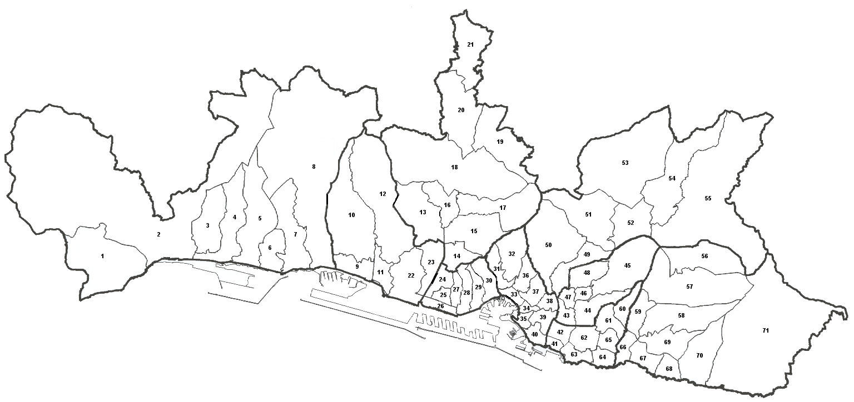
A proposal for the city of Genova
Small Area : 71 Town Units (Unità Urbanistiche)
(Average population: ≈ 8500)
Old Municipalities annexed to Greater Genova since 1926
Notes:
NON SO COME TRADURRE UNITA’ URBANISTICHE: IO HO USATO TOWN UNITS MA NON HO IDEA

Slide 10
Variables
Variable | Authors used previously similira variables
Low education | Julkunen, Pampalon
Income | Julkunen
Overcrowded houses | Jarman, Townsend, Forrest e Gordon
Born in Southern Italy/Islands | Bauman a livello europeo utilizza la variabile analoga (Nazionalità non rientrante nell’Europa occidentale)
Old-age-dependency ratio | Julkunen, Pampalon, Baumann
Elderly living alone | Jarman, Forrest e Gordon, Pampalon
Resident Immigrants | Jarman
Immigrants in schools | Testi e Ivaldi
Families in rented houses | Townsend, Caranci
Divorced | Pampalon
Unemployment | Jarman, Townsend, Forrest e Gordon, Julkunen, Pampalon, Baumann
Buildings in poor conditions | Perez-Mayo utilizza come variabile le condizioni abitative
Single-parent families | Jarman, Forrest e Gordon, Julkunen,
Single person households | Julkunen,Pampalon
Notes:
Questa e’ una figura non posso scriverci sopra

Slide 11
Selection of variables
Factorial Analysis:
“if two variables show a strong correlation with the same factor , a non- negligible fraction of their correlation is accounted for by having a common factor”
(Dillon e Goldstein, 1984)
The score obtained by an analytical unit for a variable can be xpressed as the linear combination of the common factors with the unique factor of the variable
F1
F2
a11
a12
a31
a32
a21
a22
Z1
Z2
Z3
U1
U2
U3
Z_{ik} =F_{i1} a _{k1} + F_{i2} a _{k2} +....+ F_{im} a _{km} + u _{ik}

Slide 12
Interpretation of variables: indentification of 4 factors capable to represent two dimensions of deprivation: SOCIAL and MATERIAL (Townsend,1987)
Variabili | I Fattore | II Fattore | III Fattore | IV Fattore
Bassa istruzione | 0,973 | 0,120 | 0,005 | 0,023
Reddito | 0,883 | 0,285 | 0,175 | 0,293
Sovraffollamento | 0,873 | 0,156 | -0,063 | -0,017
Nati nelle Isole e nel sud Italia | 0,751 | 0,337 | 0,236 | -0,134
Indice di vecchiaia | -0,201 | -0,884 | -0,115 | -0,128
Anziani soli | -0,360 | -0,830 | -0,049 | 0,085
Stranieri residenti | 0,025 | 0,618 | 0,338 | 0,614
Stranieri nelle scuole | 0,273 | 0,598 | 0,285 | 0,505
Famiglie in affitto | 0,309 | 0,268 | 0,739 | -0,147
Divorziati | -0,400 | -0,193 | 0,762 | 0,088
Disoccupazione | 0,603 | 0,306 | 0,654 | 0,010
Edifici in stato mediocre o pessimo | 0,148 | 0,201 | 0,648 | 0,107
Famiglie monoparentali | -0,176 | -0,035 | 0,348 | -0,789
Famiglie unipersonali | -0,390 | 0,019 | 0,459 | 0,753
Table of saturation of variables on factors
Representation of the variance explained by the identified factors
Component | Rotation Sums Square Loadings
 | Total | % of variance | Cumulative %
1 | 4,22 | 29,444 | 29,444
2 | 2,687 | 19,191 | 48,635
3 | 2,539 | 18,132 | 66,768
4 | 1,963 | 14,020 | 80,787

Slide 13
Selected Variables
Material Deprivation
Low education
Income
Overcrowded housholds
Born in Southern Italy/Islands
Families in rented houses
Divorced
Unemployment
Social Deprivation
Old-age-dependency ratio
Elderly living alone
Resident Immigrants
Immigrants in schools
Single-parent families
Single person households

Slide 14
Two non-compensative methodologies for aggregating variables in indices
1) Mazziotta-Pareto Index (MPI)
Non-compensative, non-parametric.
2) Peña Distance Index (DP2)
Non-compensative, parametric

Slide 15

MPI
NON COMPENSATIVE NON-PARAMETRIC
Standardization of the variables
z_{ij} = 100 +/- 10 (depending on the direction of the correlation)
b) Aggregation
MPIi = µzi - σzi cvzi
Coefficient of Variation
Mean of the standardized values zi
Standard Deviation

Slide 16
5. Results
Comparison between the metodologies
Rank | N° UU | Descrizione UU | MPI Materiale | N° UU | Descrizione UU | DP2 Materiale
1 | 39 | S.VINCENZO | 87,07 | 40 | CARIGNANO | 3,60
2 | 40 | CARIGNANO | 87,16 | 39 | S.VINCENZO | 3,68
3 | 65 | PUGGIA | 87,43 | 37 | CASTELLETTO | 3,83
4 | 38 | MANIN | 88,64 | 65 | PUGGIA | 4,06
5 | 37 | CASTELLETTO | 88,76 | 36 | S.NICOLA | 4,12
... | ... | ..... | ... | ... | ... | ...
67 | 33 | PRE' | 108,43 | 17 | BEGATO | 13,41
68 | 29 | ANGELI | 109,28 | 29 | ANGELI | 14,56
69 | 18 | BOLZANETO | 109,45 | 33 | PRE' | 14,77
70 | 19 | MOREGO | 109,90 | 19 | MOREGO | 15,16
71 | 3 | CA NUOVA | 126,24 | 3 | CA NUOVA | 22,57
The distributions of the material indeces shows a Spearman correlation
= 0,983
Rank | N° UU | Descrizione UU | MPI Sociale | N° UU | Descrizione UU | DP2 Sociale
1 | 19 | MOREGO | 83,47 | 19 | MOREGO | 0,41
2 | 12 | BORZOLI OVEST | 89,06 | 20 | S.QUIRICO | 2,33
3 | 20 | S.QUIRICO | 89,64 | 56 | BAVARI | 2,99
4 | 52 | S.EUSEBIO | 92,48 | 12 | BOZOLI OVEST | 3,68
5 | 56 | BAVARI | 92,65 | 13 | BORZOLI EST | 4,05
... | ... | ... | ... | ... | ... | ...
67 | 41 | FOCE | 105,12 | 50 | PANTALEO | 7,33
68 | 24 | CAMPASSO | 105,24 | 41 | FOCE | 7,59
69 | 50 | PANTALEO | 105,32 | 24 | CAMPASSO | 7,95
70 | 43 | S.AGATA | 105,36 | 47 | MARASSI | 8,12
71 | 47 | MARASSI | 107,36 | 3 | CA NUOVA | 8,44
The sociali indeces: 0,856
The strong correlation of the results obtained allows to use only one metodology : MPI

Slide 17
The rappresentation of the results:
Hyerarchical Cluster Analysis: Ward Method
Groupings homogeneous on the rank of the statistical units
5 Classes of increasing deprivation

Slide 18
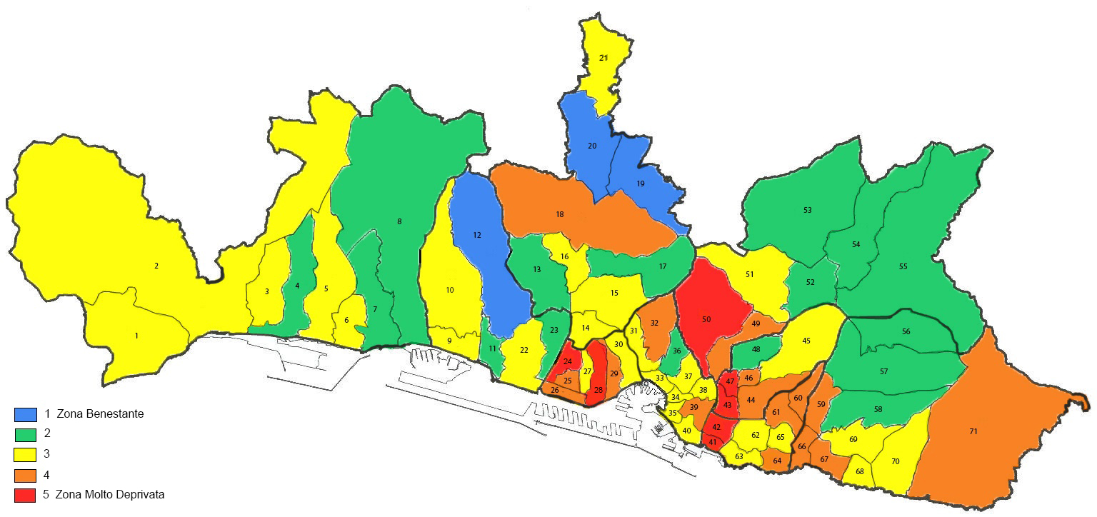
DISTRIBUTION OF SOCIAL DEPRIVATION

Slide 19
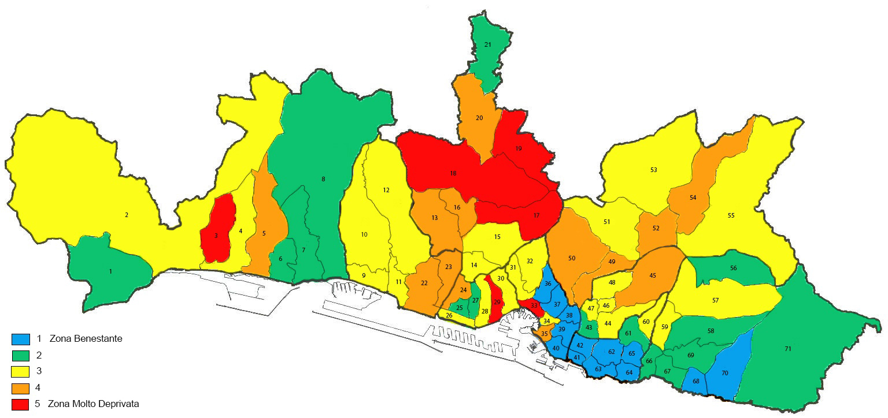
Territorial distribution: MATERIAL DEPRIVATION

Slide 20
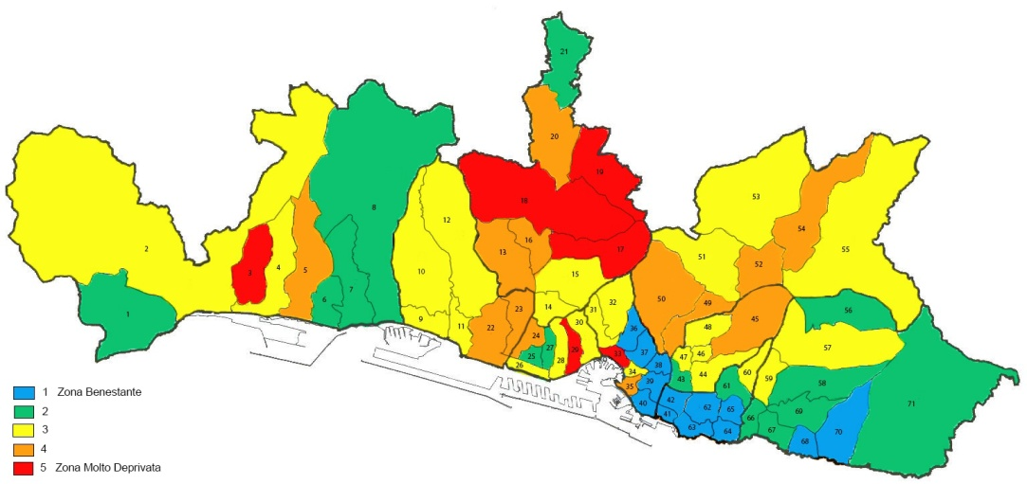

Material Deprivation
Social Deprivation
No correlation between indeces of material and social deprivation: Spearman coefficient = -0,110.
The two dimension of the deprivation must be considered separately

Slide 21
Correlation with premature mortality
Generic measure of Health : SMR (2011-2013) population under 65 years
Material deprivation class | SMR
1 | 0,71
2 | 0,85
3 | 1,01
4 | 1,15
5 | 1,58
Spearman Coefficient between Materiale MPI and SMR: 0,583
Positive correlation
!
Social deprivation class | SMR
1 | 1,40
2 | 0,91
3 | 0,99
4 | 1,05
5 | 0,97
Spearman Coefficient between Social MPI and SMR = -0,098
No correlation between the indeces
?

Slide 22
How many deaths could be prevented (in theory) by removing material deprivation?
Best condition
Relative risk condition
Material Deprivation class | Observed Deaths (<65 years) | SMR | Relative risk (SMR class/ SMR class 1) | Expected deaths at the same ratio of mortality of class1(population* Rielative risk) | Death due to the deprivation (Obs– Exp) | Attributable risk( %)
1 | 296 | 0,71 | 1 | 296 | 0 | 0%
2 | 398 | 0,85 | 1,19 | 334,27 | 63,72 | 16%
3 | 981 | 1,01 | 1,41 | 694,87 | 286,13 | 29%
4 | 498 | 1,15 | 1,61 | 308,07 | 189,92 | 38%
5 | 280 | 1,58 | 2,22 | 125,78 | 154,21 | 55%
Genova | 2453 | -- | -- | 1759,01 | 693,99 | 28%
Deaths explained by the Material Deprivation
Proportion of deaths attributable to living in material deprivation conditions

Slide 23
Analisys of the Small Area
From the Town Unit of Bolzaneto extrapolation of the census sections relative at the neighborhood of Murta and recalculation of the MPI Indeces with 72 town units
Murta is in 23°position for material index and is 2° for the social index
Bolzaneto gets worse and goes into penultimate position for both indeces
TEST SMALL AREA
The choice of the small area has significant effects

Slide 24
The modiﬁable area unit problem (MAUP)
“Refers to the problem that occurs when inferences—based on spatial analysis—change when the same data are analyzed using either variations in administrative zoning or through different scales”.
(Schuurman, 2007)

Slide 25
SCALE EFFECT:
“is the tendency, within a system of modiﬁable areal units, for different statistical results to be obtained from the same set of data when the information is grouped at different levels of spatial resolution”

Slide 26
ZONING EFFECT:
“is the variability in statistical results obtained within a set of modiﬁable areal units as a function of the various ways that these units can be grouped at a given scale, and not as a result of the variation in the size of those areas”

Slide 27
In our work only the first componet of MAUP is detected : the small area analysis shows how different results can be obtained by changing the resolution of the area used as unit :
!
Bolzaneto
in both dimensions of deprivation
Murta
Good ranks in both dimensions
Murta had a positive influence on Bolzaneto results in the first formulation in 71 TU

Slide 28
6. Discussion and Conclusions
In agreement with the available literature our results show :
There is a positive correlation between material deprivation and health (all cause mortality);
There is no immediate relation between social deprivation and health;

Slide 29
Spatial extent at which the indices are calculated has an effect on their values
This inﬂuences not only the results of the analyses based on such data, but also how these results can be interpreted

Slide 30
Further work
Analysis of the zoning effect in the urban area of Genoa
Influence of MAUP on the interpretation of the results of area-based studies of deprivation conditions and on policy decisions.

