Slide 1
A proposal to measure country risk in OECD countries with MPI index Enrico Ivaldi*, Carolina Bruzzi**, Riccardo Soliani*** Ilaria Parisi***, Pietro Stanislao Parisi*** * University of Genova, Department of Political Science and Centro de Investigaciones en Econometrìa, Universidad de Buenos Aires, Argentina ** University of Genova, Department of Political Science and PhD in Economics *** University of Genova, Department of Political Science

Slide 2
Country Risk
Country Risk covers a mix of risks
They emerge when financial or commercial exchange flows arise, or investments are made in a foreign country
They may reveal unsustainable (Ivaldi 2013).

Slide 3
Different Approach
In the 1960s and 1970s Country Risk was calculate only on qualitative types of analyses
From the 1980s the analyses have become markedly quantitative, to forecast default danger or financial crisis
Now MULTIDIMENSIONAL APPROACH:
Macroeconomic fragility and geopolitical risks (Meldrum 2000)

Slide 4
Different methods
In the studies on country crises throughout time, the methods applied are different, e. g.:
Variable selections through the principal component analysis, which allows the reduction of variables to include in the index in a new mix of “latent” variable rundowns, (Levy and Yoon 1996)
Construction of a Country Risk index on the level of geographical areas (Carment 2001)
MHDIS (Multi-group Hierarchical Discrimination) analysis by Doumpos and Zopounidis (2002), which compares different analysis methods for developing countries
Notes:
In the studies on country crises throughout time, the methods applied are different: e. g., the variable selections through the principal component analysis, which allows the reduction of variables to include in the index in a new mix of “latent” variable rundowns, (Levy and Yoon 1996); the construction of a Country Risk index on the level of geographical areas (Carment 2001); the MHDIS (Multi-group Hierarchical Discrimination) analysis by Doumpos and Zopounidis (2002), which compares different analysis methods for developing countries; the two different models by Hammer et al. (2004): the first one based on multiple linear reversion, and the second that uses a logical analysis of data technique (LAD).

Slide 5
DIFFERENT METHODS
Two different models by Hammer et al. (2004): the first one based on multiple linear reversion, and the second that uses a logical analysis of data technique (LAD)
Nath (2008) argues for the necessity to enlarge the field of analysis, create more fitting models, and face new challenges
Cukier and Mayer-Schoenberger (2013) underline the new researchers’ ability of using “big data”

Slide 6
Variable selection (i)
We construct an index based on currently available data, which do not require ad hoc surveys and come directly from certified sources (Jarman 1983, 1984; Forrest and Gordon, 1993; Gordon and Pantazis 1997, Townsend 1987)
… In order to skip additional costs and update indexes simply and continuously
To define the field of research, we have done a first test on data supplied by official research bodies and statistical institutions (Ivaldi and Testi 2010).

Slide 7
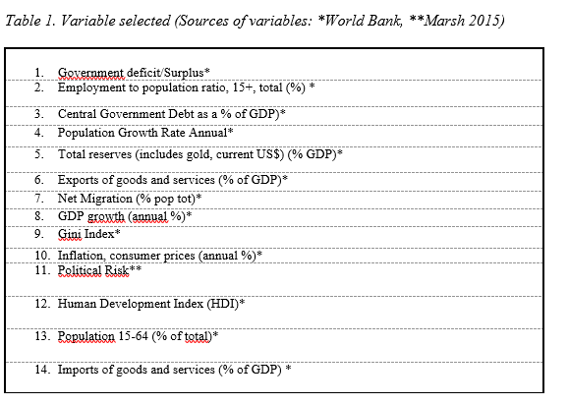
Variable selection (iI)
The study concentrates on a mix of variables consistent with most of literature (Levy and Yoon 1996, Carment 2001, Doumpos et al. 2001, Hammer et al. 2004; Doumpos and Zopounidis 2002;, Ivaldi and Di Gennaro 2011)

Slide 8
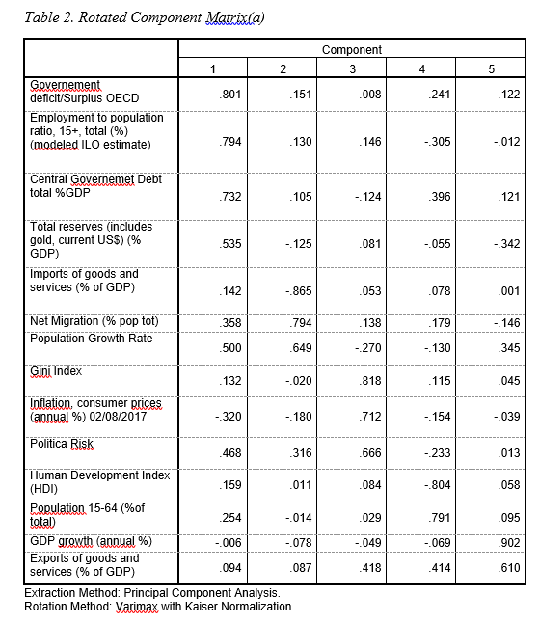
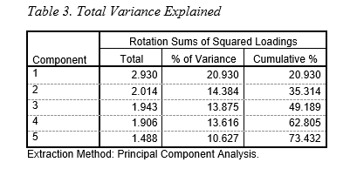
Variable selection (iII)
To select indicators, principal component analysis (PCA) has been applied.
Since the second component explains just 62% of the variance we take into account all three components, without excluding any variable

Slide 9
Construction of THE Index: Weight
Although to assign different weights to the various factors considered could appear attractive, in fact no reliable basis for doing this does it exist (Myer & Jencks, 1989, Testi and Ivaldi 2009).
However, even equal weighting makes an implicit assumption on the weights being equal (Nardo, Saisana, Tarantola, Hoffman, & Giovannini, 2005).

Slide 10
Mazziotta Pareto Index (MPI) (I)
After the selection …
Aggregation to obtain a Country Risk Index (CRI)
We propose a non-compensatory methodology: the Mazziotta Pareto Index (MPI)
It assumes the ‘‘non-substitutability’’ of the dimensions:
the same importance
no compensation among them
Not only does it consider quantitative variables, but also qualitative elements, which play there a key role
Even though based on a small number of variables, the MPI can assess quite correctly the pre-figurative “latent dimensions” of the CR in the short run

Slide 11
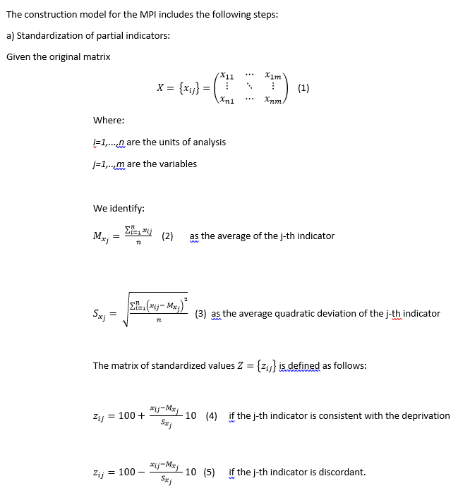
Mazziotta Pareto Index (MPI) (II)
We have transformed the indicators into distributions with average 100 and average squared deviation 10 in a common scale, thus excluding the effects of the unit of measure of each indicator.
This type of standardization also enjoys the "dual" property, i.e. it keeps variability between the units unchanged, regardless of the correlation between the indicators and the phenomenon to be measured.

Slide 12
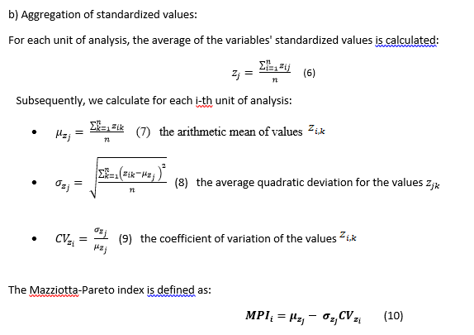
Mazziotta Pareto Index (MPI) (III)
Through the coefficient of variation, this index allows to assign penalties to the units of analysis that have unbalanced variability with respect to the average.
In fact, ${CV}_{z_{i}}$= 0 when the values of the indicators are equal and therefore the MPI coincides with the arithmetic mean of the indicators.

Slide 13
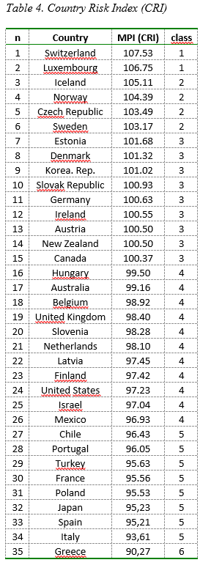
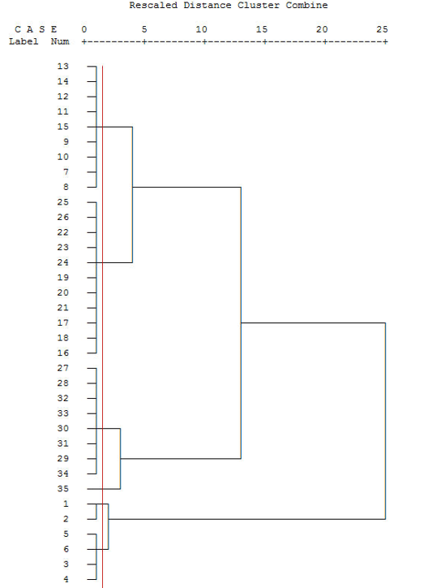
CLASS Aggregation
The scores have been reckoned and the rankings set up. The index places 107.50 for Switzerland (the lowest CR) and 90,28 for Greece, which shows the highest CR.
To complete the analysis, we divide the countries in classes, to make easier the comparison between the two indices. We apply a cluster analysis (Nardo, Saisana, Tarantola, Hoffman, & Giovannini, 2005)

Slide 14
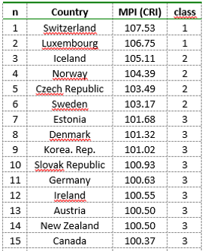
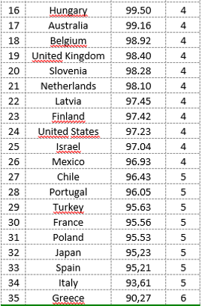
Discussion
Our indicator classifies the Ocse countries into six main groups, according to their high or low country risk. Looking at the entire classification, we have results partly as expected, but partly in contrast with historical tendencies or the rating based on a single criterion
In the first class we have a couple of countries with high standards of living and efficient and stable markets.
The second class includes countries scarcely affected by the financial crisis.
In the third class there are emerging countries and solid rich states, which have been affected by the crisis and have reduced their export.
Also the fourth group is heterogeneous
In the fifth class there are big countries of the UE, together with Poland and Portugal, and, out of Europe, Chile, Turkey and Japan. Political instability, crime, social and territorial inequality, public debt, unemployment, slump in household consumption affect more or less all of them
Finally, Greece is at the last level. It has been experiencing recession and unemployment and also environmental crisis (a problem which receive less attention). In 2010, when the country neared bankruptcy, the debt with Europe and IMF soared, triggering internal political tension and the concrete risk of Grexit from UE.

Slide 15
Conclusions (I)
Country-level risk, often complex, integrated and fast changing, together with its cumulative impacts represents a real vexing challenge for businessmen, governmental bodies, NGOs, and other types of organizations, as well as for researchers and students
Our proposed index can help to find the existence of potential risks for the operators, on the basis of a limited number of variables. Thus operators will be able to formulate a better quantitative and qualitative estimate of the ongoing events over a short period

Slide 16
CONCLUSIONS (II)
Measuring the Country Risk is a continuous work in progress. The proposed index sheds light particularly on the risk linked to political and economic conditions
CRI assesses international country risk ratings comparatively, and singles out the relevance of economic, financial and political risks as components of a general risk rating.

